Slide 1


AutoDRIVE-AVLDC Integration
Chinmay Vilas Samak
PhD Candidate, CU-ICAR
csamak@clemson.edu
Tanmay Vilas Samak
PhD Candidate, CU-ICAR
tsamak@clemson.edu

Slide 2
Project Overview
Simulation
Simulated sensors interface with the ADAS/AD stack, which passes controls commands to the simulated vehicle dynamics model, driving in a virtual environment.
Emulation
Simulated ground truths bypass the perception stack to interface directly with the planning/control stack, which controls the virtual/physical vehicle in a virtual environment.
Stimulation
Virtual/physical sensors and actuators are stimulated through environment simulation, and ADAS/AD stack controls the virtual/physical vehicle in a virtual environment.

Slide 3


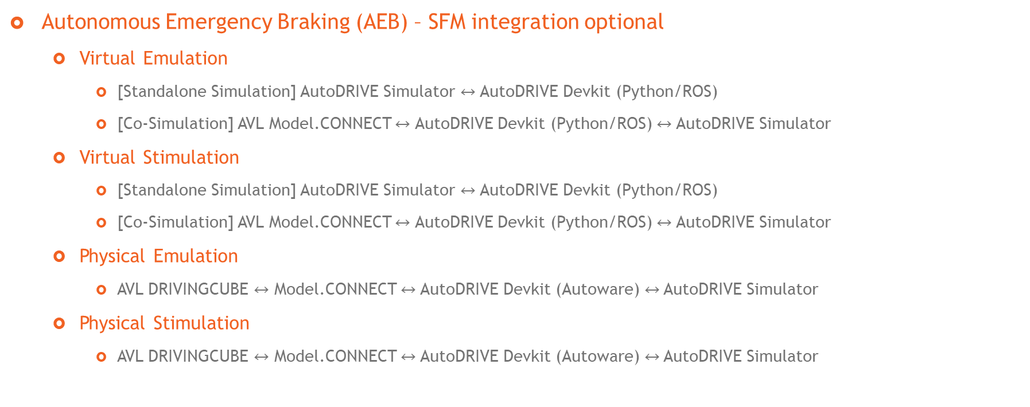
Project Plan
Autonomous Emergency Braking (AEB) – SFM integration optional
Virtual Emulation
[Standalone Simulation] AutoDRIVE Simulator $↔$ AutoDRIVE Devkit (Python/ROS)
[Co-Simulation] AVL Model.CONNECT $↔$ AutoDRIVE Devkit (Python/ROS) $↔$ AutoDRIVE Simulator
Virtual Stimulation
[Standalone Simulation] AutoDRIVE Simulator $↔$ AutoDRIVE Devkit (Python/ROS)
[Co-Simulation] AVL Model.CONNECT $↔$ AutoDRIVE Devkit (Python/ROS) $↔$ AutoDRIVE Simulator
Physical Emulation
AVL DRIVINGCUBE $↔$ Model.CONNECT $↔$ AutoDRIVE Devkit (Autoware) $↔$AutoDRIVE Simulator
Physical Stimulation
AVL DRIVINGCUBE $↔$ Model.CONNECT $↔$ AutoDRIVE Devkit (Autoware) $↔$AutoDRIVE Simulator

Slide 4
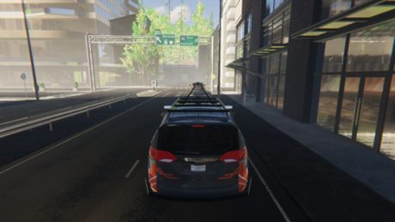
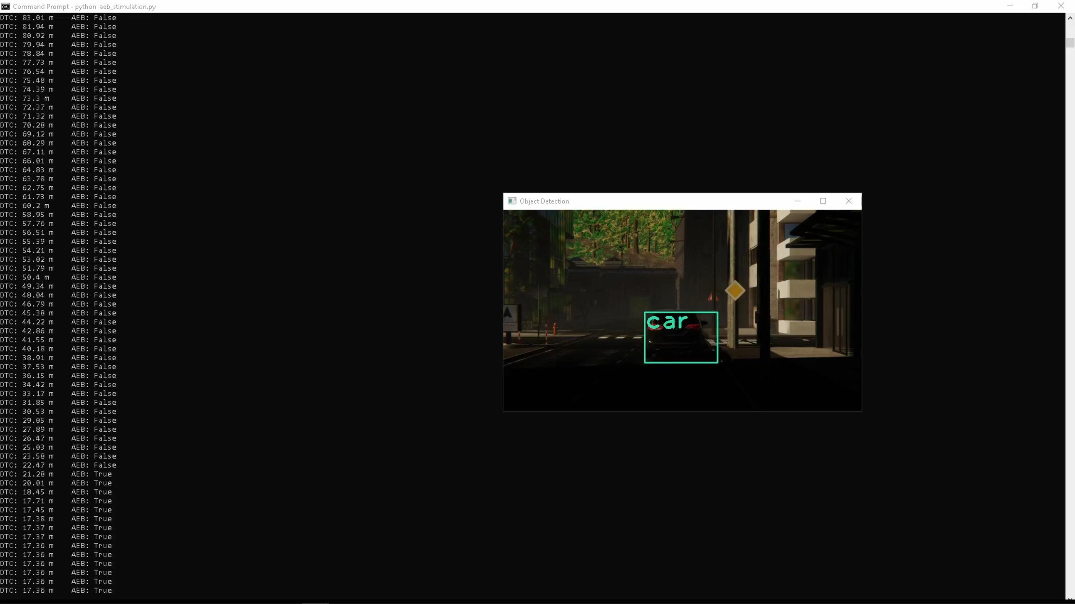





Standalone Simulation Framework
DTC, Camera
Throttle,
Steering,
Brake,
Handbrake

Slide 5

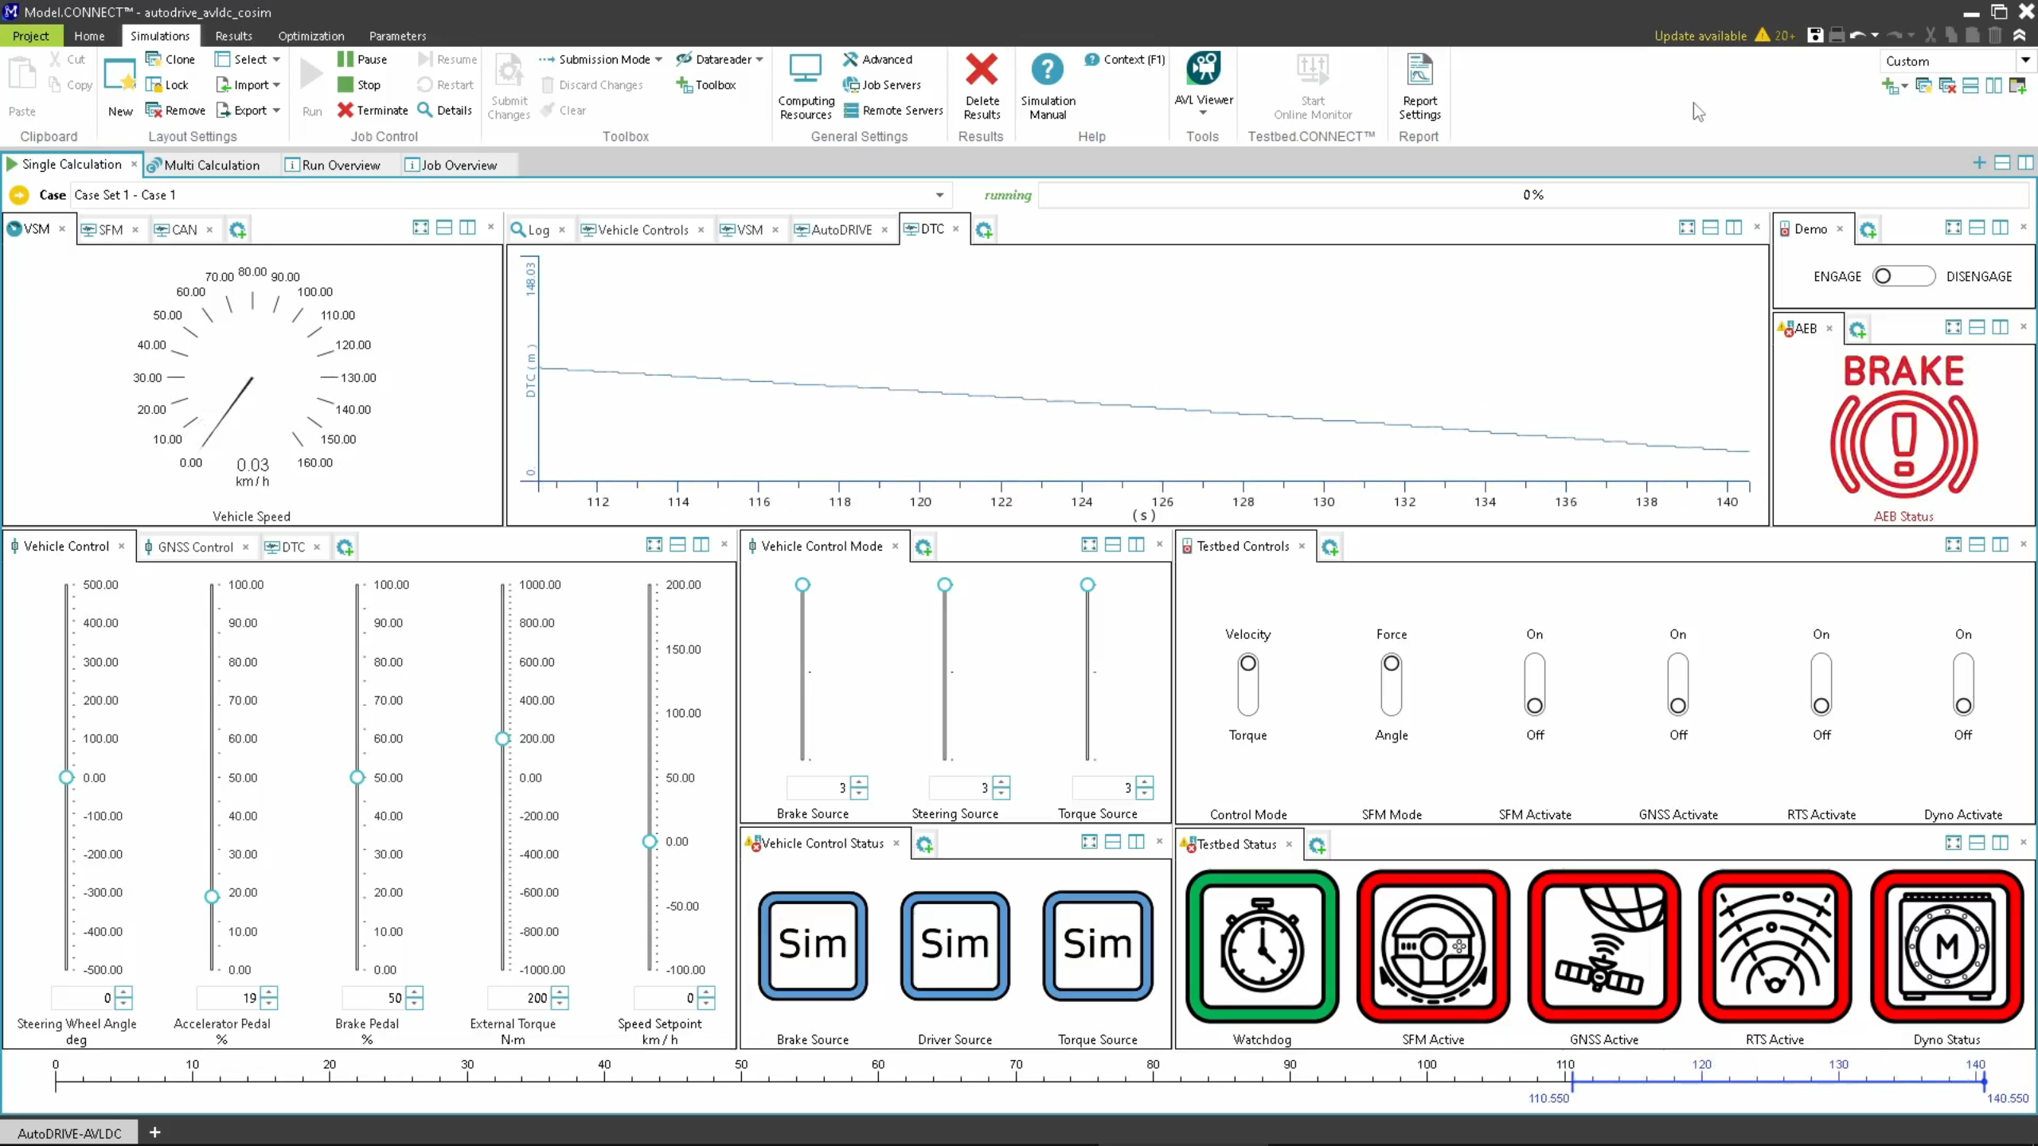
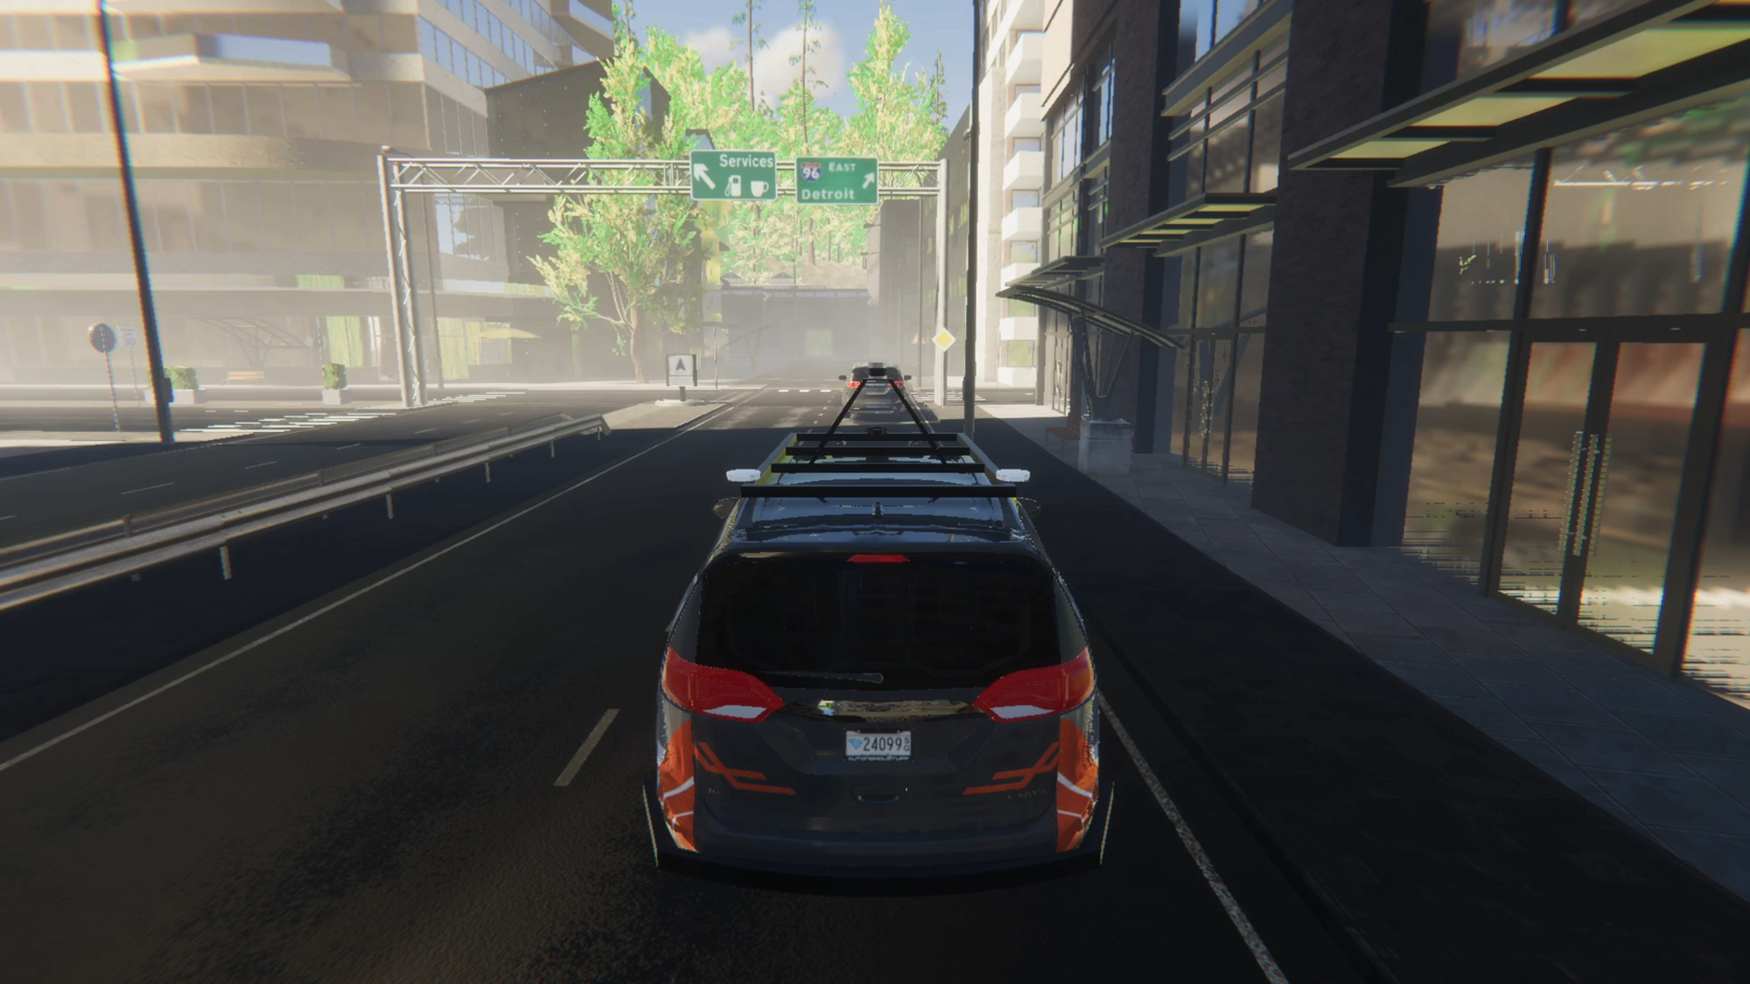






Co-Simulation Framework
DTC, Camera
DTC, AEB
States
States
Model.CONNECT™
AVL VSM™
Throttle, Steering,
Brake, Handbrake

Slide 6


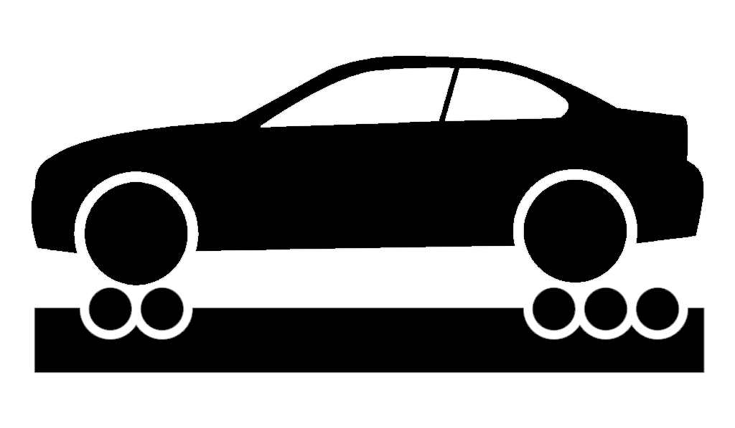




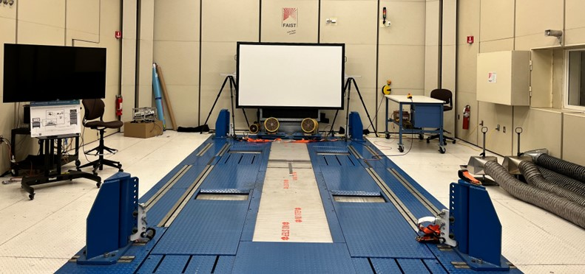
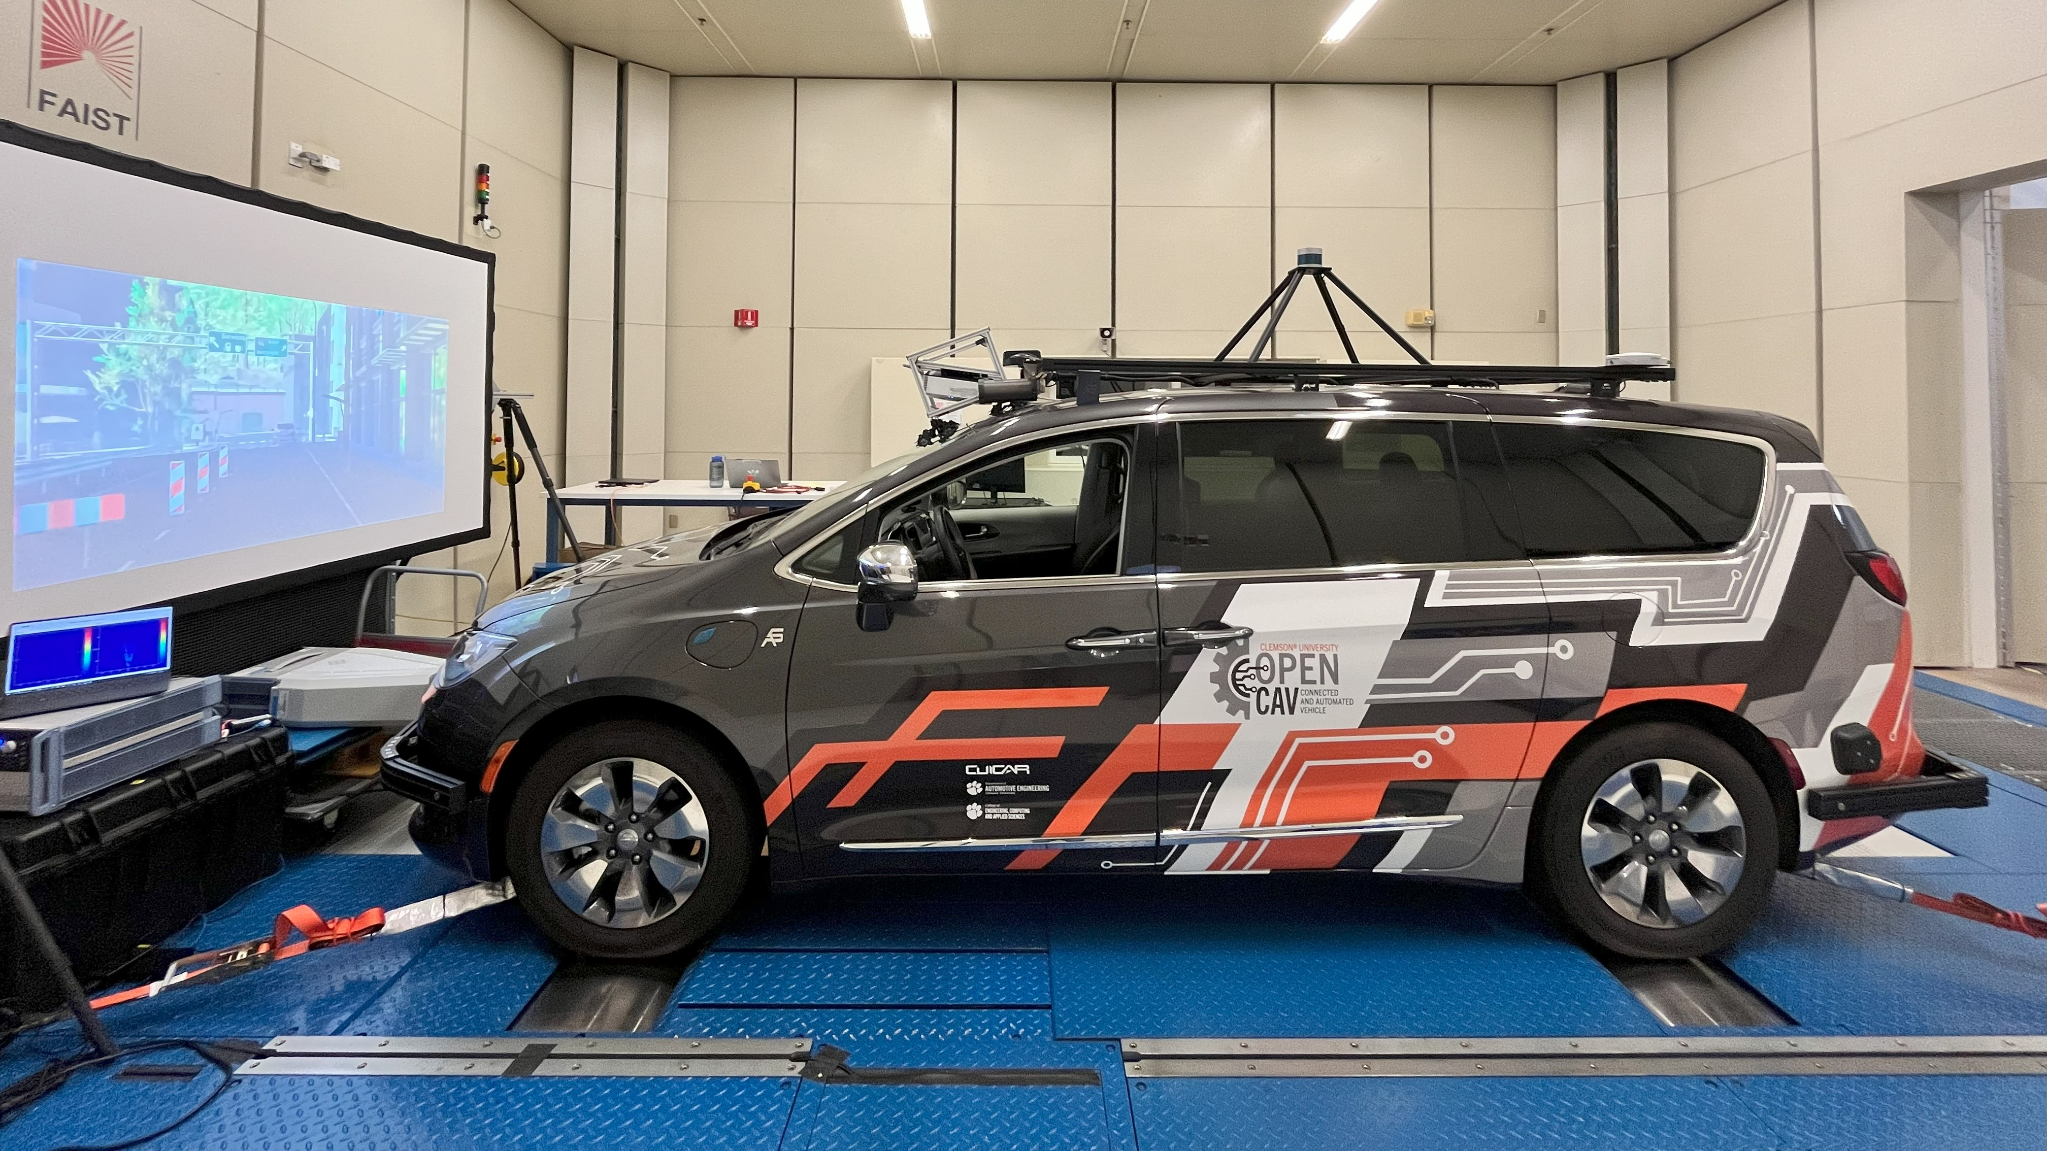




Vehicle-in-the-Loop Framework
DTC, Camera
DTC, AEB
States, Actions
States
Dyno
SFM
RTS
GNSS
Throttle,
Steering,
Brake,
Handbrake
Camera Stimulation
Road Load Conditions,
Differential Speeds
AVL DRIVINGCUBE™

